Slide 1


Projects
Excited to present my two web development projects I've been working on while doing internship under Microsoft Learn Student Ambassadors (MLSA-KIET Platform).My track was Full Stack Web Development. The first one is a basic web page(EASY) demonstrating clone of home page of Amazon and the second one is a Simple Calculator(INTERMEDIATE).
by ANANYA SRIVASTAVA

Slide 2
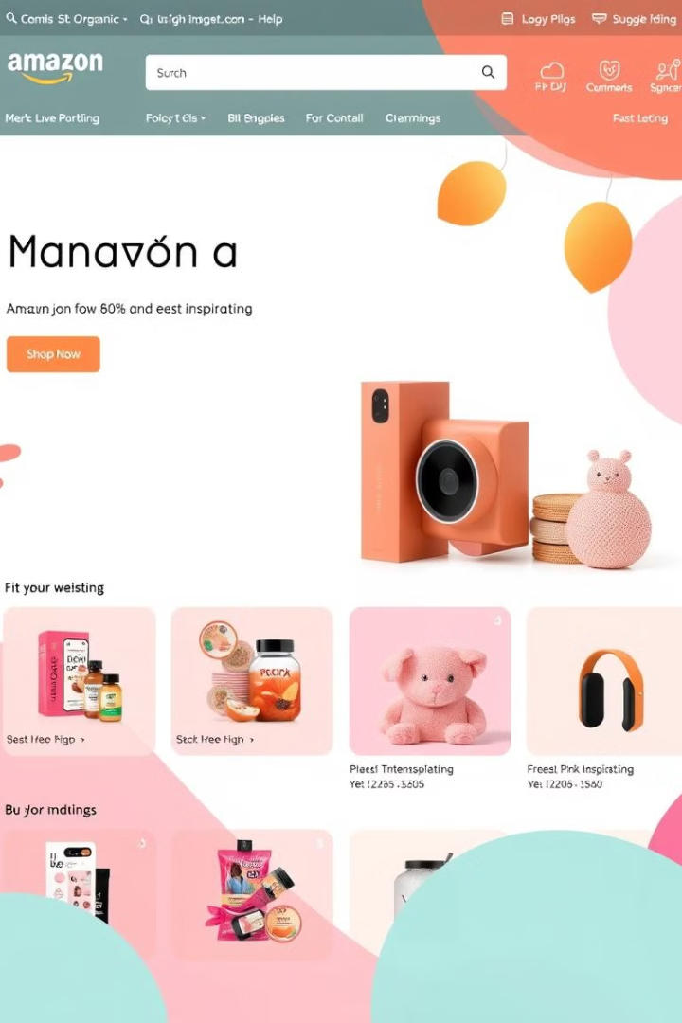
Project 1: Amazon Home Page Clone(A basic web page)
1
Recreating the Look and Feel
2
User Experience
The goal is to provide a user-friendly experience that mirrors the original site.
Focusing on replicating the essential elements of the Amazon home page.
3
Interactive Features
We'll implement basic functionality, like search bars and product browsing.

Slide 3
HTML and CSS Only
HTML Structure
CSS Styling
We'll use HTML to create the basic layout and structure of the website.
CSS will be used to add styles, colors, fonts, and responsive design elements.

Slide 4


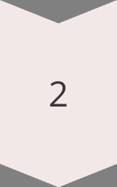
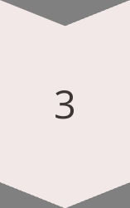
Recreating the Look and Feel
Header
The header will include the Amazon logo, search bar, and navigation menu.
Main Content
The main content area will display featured products, deals, and categories.
Footer
The footer will contain links to customer service, about us, and legal information.

Slide 5



Responsive Design
Mobile
Desktop
The website will be optimized for viewing on smartphones and tablets.
The website will maintain a consistent look and feel on desktops.

Slide 6
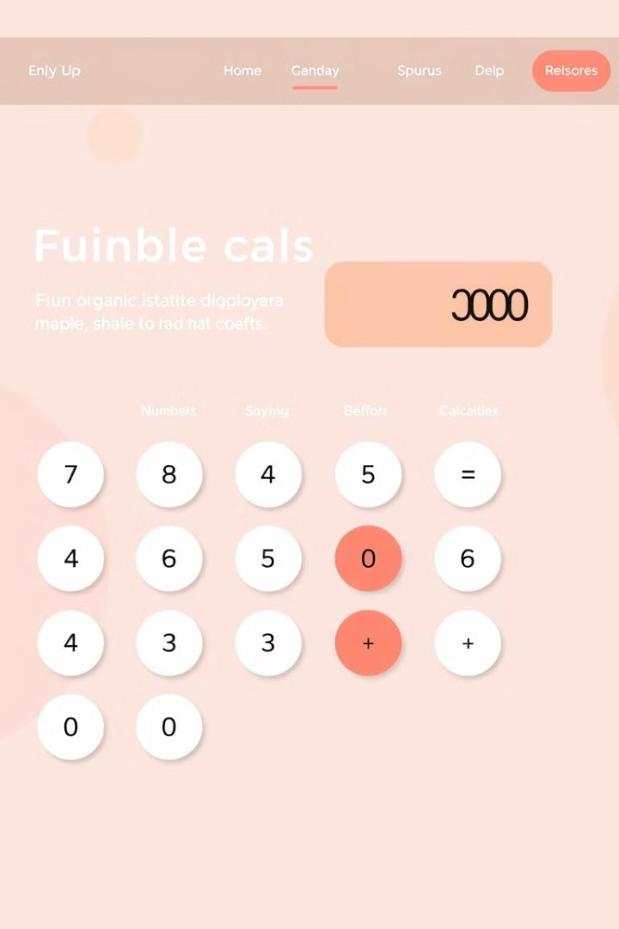
Project 2: Simple Calculator
Operation
Description
Addition
Adding two numbers together.
Subtraction
Subtracting one number from another.
Multiplication
Multiplying two numbers together.
Division
Dividing one number by another.

Slide 7
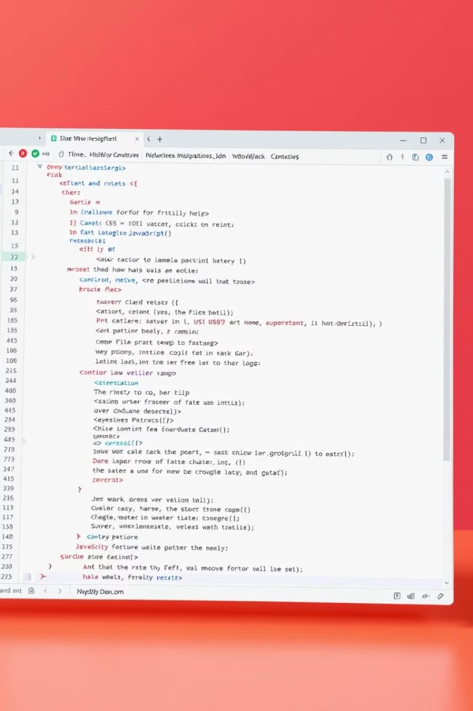
HTML, CSS, and JavaScript
1
HTML Structure
We'll use HTML to create the basic layout of the calculator.
2
CSS Styling
CSS will be used to add styles, colors, and fonts to the calculator.
3
JavaScript Functionality
JavaScript will handle user input, perform calculations, and display results.

Slide 8
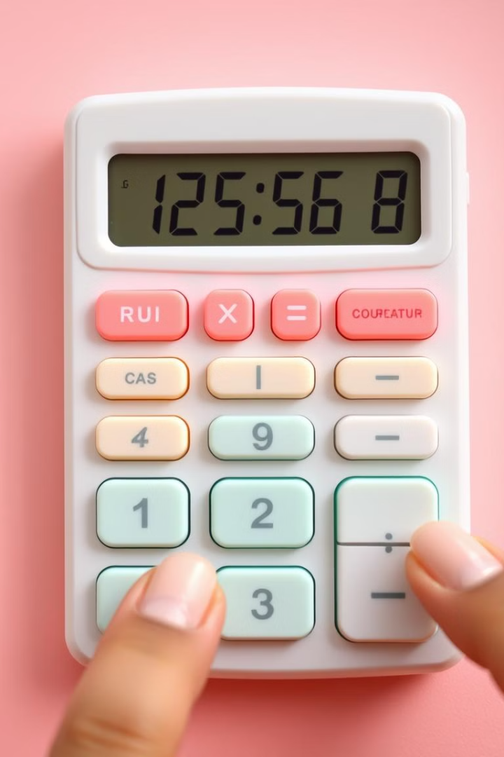
Performing Basic Arithmetic Operations
Number Input
Operator Selection
Users will input numbers using the calculator's buttons.
Users will choose the arithmetic operation they want to perform.
Calculation
JavaScript will perform the calculation and display the result.

